Slide 1

Customer Segmentation
Using K-Means clustering
Stephan Grimm
18.06.2020

Slide 2
Table of Contents
Introduction
Dataset
Clustering
Customer Segmentation
Suggestions

Slide 3
Introduction
Objective
Wide variety of customer types
Better understanding of customer base
Low cost of switching
Prevent churning
Customer Group Segmentation

Slide 4
Introduction
Objective
Wide variety of customer types
Better understanding of customer base
Low cost of switching
Prevent churning
Customer Group Segmentation
Questions to be answered:
Are there different groups of customers?
Are there groups worth saving?

Slide 5
Dataset

Slide 6
Dataset
Variables
Categorical
'State'
'Area code'
'International plan'
'Voice mail plan'
'Churn'
Numerical
'Account length',
'Number vmail messages'
'Customer service calls'
'Total day minutes'
'Total eve minutes'
'Total night minutes'
'Total intl minutes'
'Total day calls'
'Total eve calls'
'Total night calls'
'Total intl calls'
'Total day charge'
'Total eve charge'
'Total night charge'
'Total intl charge'

Slide 7
Dataset
Variables
Categorical
'State'
'Area code'
'International plan'
'Voice mail plan'
'Churn'
Numerical
'Account length',
'Number vmail messages'
'Customer service calls'
'Total day minutes'
'Total eve minutes'
'Total night minutes'
'Total intl minutes'
'Total day calls'
'Total eve calls'
'Total night calls'
'Total intl calls'
'Total day charge'
'Total eve charge'
'Total night charge'
'Total intl charge'
Reduced Variables
Categorical
'Churn'
Numerical
'Account length',
'Number vmail messages'
'Customer service calls'
'Total minutes'
'Total calls'
'Total charge'

Slide 8
Dataset
Variables
Categorical
'State'
'Area code'
'International plan'
'Voice mail plan'
'Churn'
Numerical
'Account length',
'Number vmail messages'
'Customer service calls'
'Total day minutes'
'Total eve minutes'
'Total night minutes'
'Total intl minutes'
'Total day calls'
'Total eve calls'
'Total night calls'
'Total intl calls'
'Total day charge'
'Total eve charge'
'Total night charge'
'Total intl charge'
Reduced Variables
Categorical
'Churn'
Numerical
'Account length',
'Number vmail messages'
'Customer service calls'
'Total minutes'
'Total calls'
'Total charge'
Final Dataset
3333 Customers
6 Numerical Variables
Churn rate

Slide 9
Clustering

Slide 10
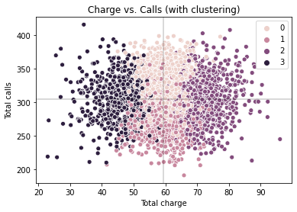
Customers can be split into 4 Clusters
Total charge and calls explain the most variance in the data
40% of total variance

Slide 11
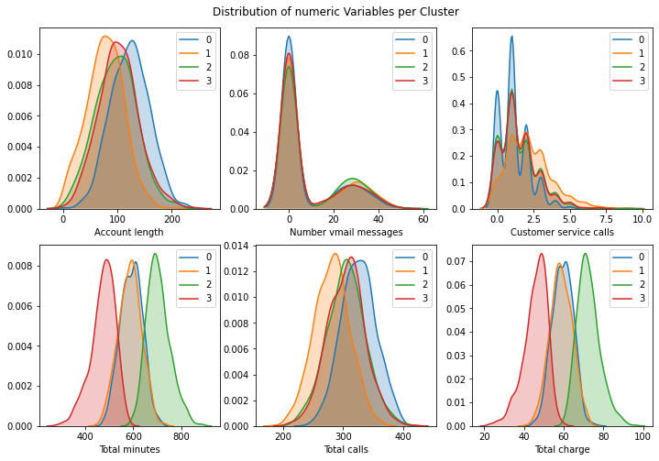
2 Groups will deviate
Clusters vary in:
Account length
Customer service calls
Total minutes
Total calls
Total charge

Slide 12
Customer Segmentation

Slide 13
Happy, long time customers
Group 0 vs. Average +- Std:
Account length: 123.1, (101.1 +- 39.8)
Customer service calls: 1.1, (1.6 +- 1.3)
Total calls: 325.8, (305.1 +- 34.4)
Churn rate: 6.64% (14.49%)
Sales:
Group size: 29.8%
Sales percentage: 29.9%
Sales lost: 2.0%

Slide 14
New, complaining customers
Group 1 vs. Average +- Std:
Account length: 77.5, (101.1 +- 39.8)
Customer service calls: 2.2, (1.6 +- 1.3)
Total calls: 281.4, (305.1 +- 34.4)
Churn rate: 11.72% (14.49%)
Sales:
Group size: 25.9%
Sales percentage: 25.6%
Sales lost: 3.0%

Slide 15
Emergency only
Group 3 vs. Average +- Std:
Total minutes: 475.4, (591.9 +- 90.0)
Total charge: 45.9, (59.4 +- 10.5)
Churn rate: 11.14% (14.49%)
Sales:
Group size: 21.3%
Sales percentage: 16.4%
Sales lost: 1.8%

Slide 16
Talkers
Group 2 vs. Average +- Std:
Total minutes: 704.5, (591.9 +- 90.0)
Total charge: 72.6, (59.4 +- 10.5)
Churn rate: 30.86% (14.49%)
Sales:
Group size: 23.0%
Sales percentage: 28.1%
Sales lost: 8.7%

Slide 17
Conclusion

Slide 18
Suggestions
Summary
Customers can be split up into 4 Clusters
“Talkers” are the only group with an above average churn rate (30%)
“Talkers” account for 9% of lost revenue
Suggestions
Focus on “Talkers”
Incentives for extensive users

